Slide 1


London neighborhood for expatriates
The Battle of Neighborhoods:
Applied Data Science Capstone

Slide 2


If you were moving to London, where would you stay?
There have been more expatriates and London is one of the popular destinations
Finding a place to stay is one of the most stressful parts of moving to another country
This project aims to help expatriates find an ideal neighborhood to stay in London

Slide 3

data
Geographical Coordinates of London Neighborhoods
Foursquare Venue Data
London Borough Profiles

Slide 4
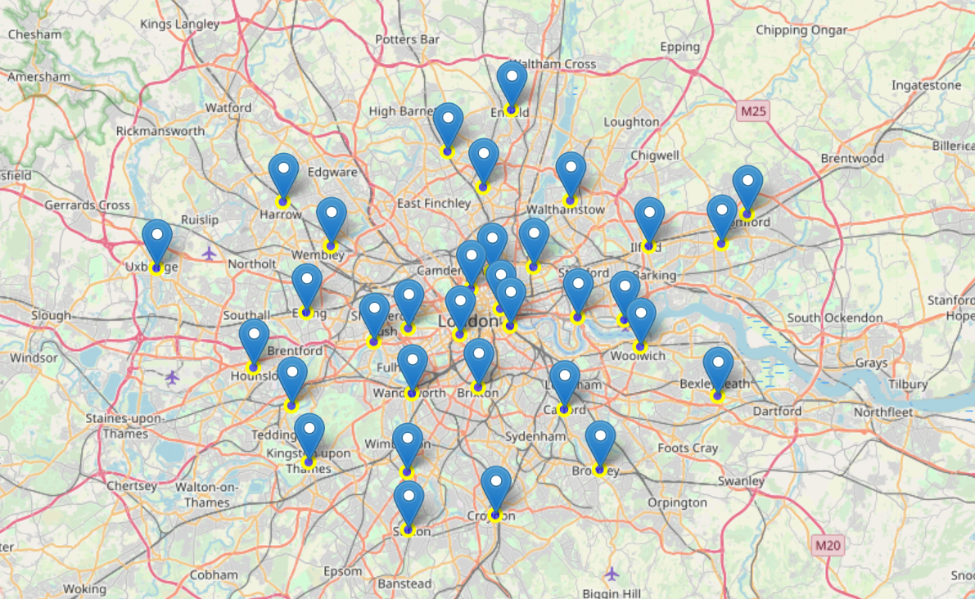
Geographical location
Geographical coordinates of all neighborhoods were taken from https://en.wikipedia.org/wiki/List_of_London_boroughs
For visualisation of neighborhoods’ spatial distribution in London

Slide 5
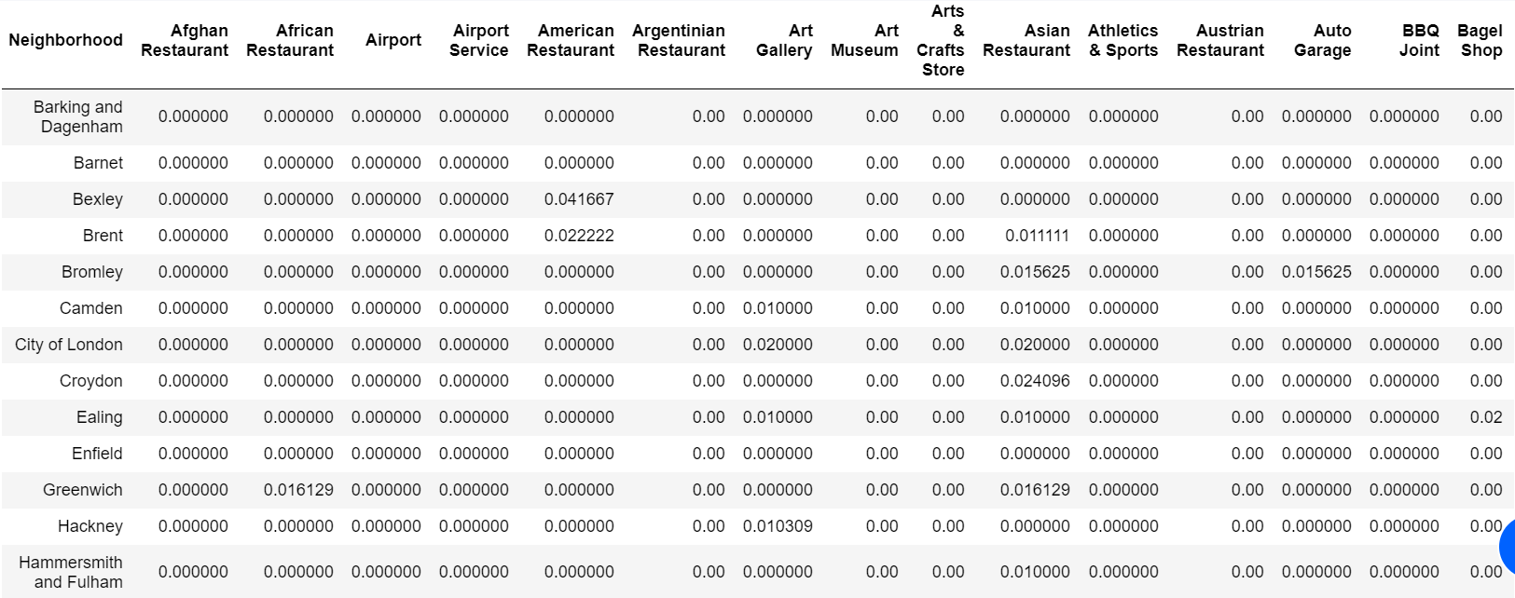
Foursquare venue data
Venues in a 1000m radius of each neighborhood were extracted from Foursquare
To get an overview of the amenities in each neighborhood

Slide 6
London borough profiles
Neighborhood | Crime rates per thousand population | Employment Rate | Average Age | Median House Price | Average Public Transport Accessibility score
City of London | 85.46 | 64.6 | 43.2 | 799999 | 7.86
Barking and Dagenham | 83.36 | 65.8 | 32.9 | 243500 | 2.97
Barnet | 62.74 | 68.5 | 37.3 | 445000 | 3.00
Bexley | 51.83 | 75.1 | 39 | 275000 | 2.55
Brent | 78.80 | 69.5 | 35.6 | 407250 | 3.65
Bromley | 64.13 | 75.3 | 40.2 | 374975 | 2.78
Camden | 123.50 | 69.2 | 36.4 | 700000 | 5.69
Croydon | 77.04 | 75.4 | 37 | 300000 | 3.22
Ealing | 75.48 | 72.7 | 36.2 | 430000 | 3.30
Enfield | 69.37 | 73 | 36.3 | 320000 | 2.97
Greenwich | 79.38 | 72.1 | 35 | 340000 | 3.44
Hackney | 99.65 | 69 | 33.1 | 485000 | 4.92
Hammersmith and Fulham | 113.23 | 77.5 | 35.7 | 730000 | 4.67
Haringey | 90.21 | 71.3 | 35.1 | 432500 | 4.31
Harrow | 50.40 | 73.9 | 38.3 | 396150 | 2.87
Havering | 62.93 | 76.5 | 40.3 | 287500 | 2.50
Hillingdon | 76.62 | 73.2 | 36.4 | 350000 | 2.36
Data taken from https://data.london.gov.uk/
Only indicators that were more helpful in choosing a neighborhood were considered (boxed in red)
Crime rate = Safety
House price = Affordability
Transport accessibility = Ease of commuting to work

Slide 7
Methodology & results
Exploratory Data Analysis
K-Means Clustering
Silhouette Score
Sorting

Slide 8
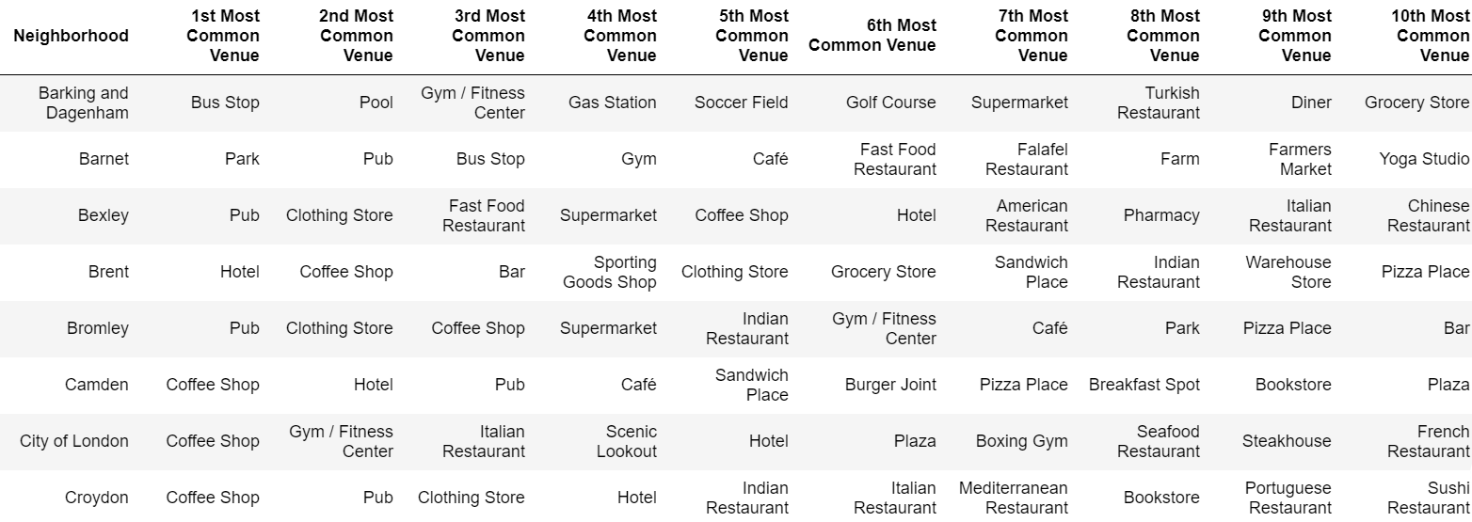
Exploratory data analysis
Top 10 most common venues in each neighborhood
Gives an indication of the kinds of conveniences associated with the neighborhood
Like to go to coffee shops? There are plenty in Camden!

Slide 9
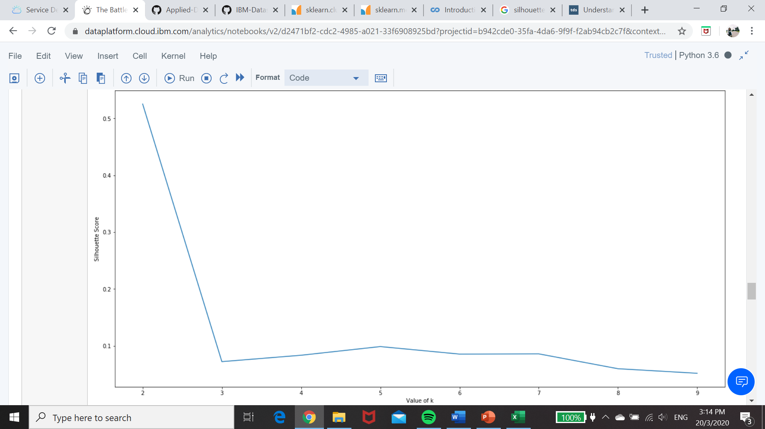
K-means clustering & Silhouette score
K-means clustering used to group neighborhoods according to similarities
Silhouette score used to determine optimum value of k
Based on graph, k=2

Slide 10
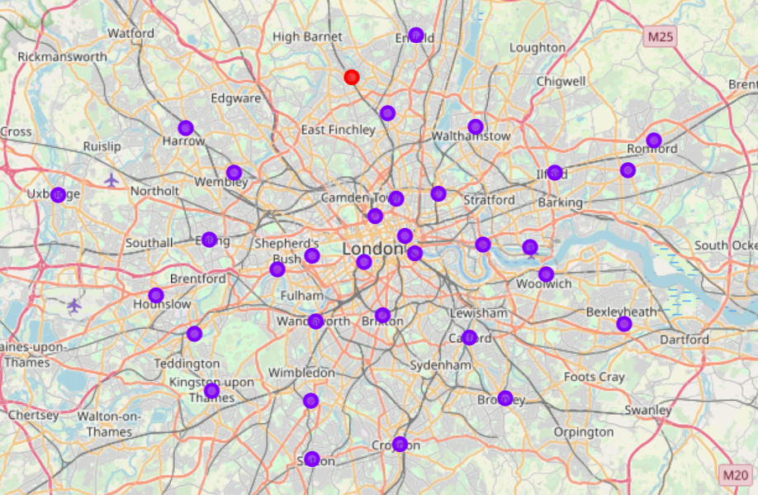
K-Means clustering
Using k=2, we find that there is only 1 neighborhood in one of the clusters

Slide 11
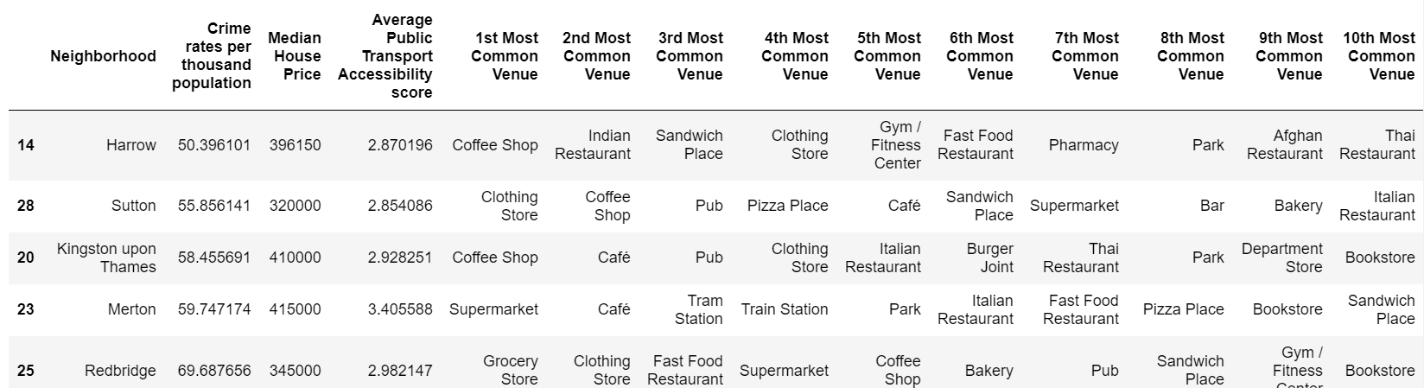
Sorting by other indicators
Crime rate from lowest to highest
House price from lowest to highest
Public transport accessibility score from highest to lowest

Slide 12
discussion
Quiet Lifestyle
Lively Environment

Slide 13
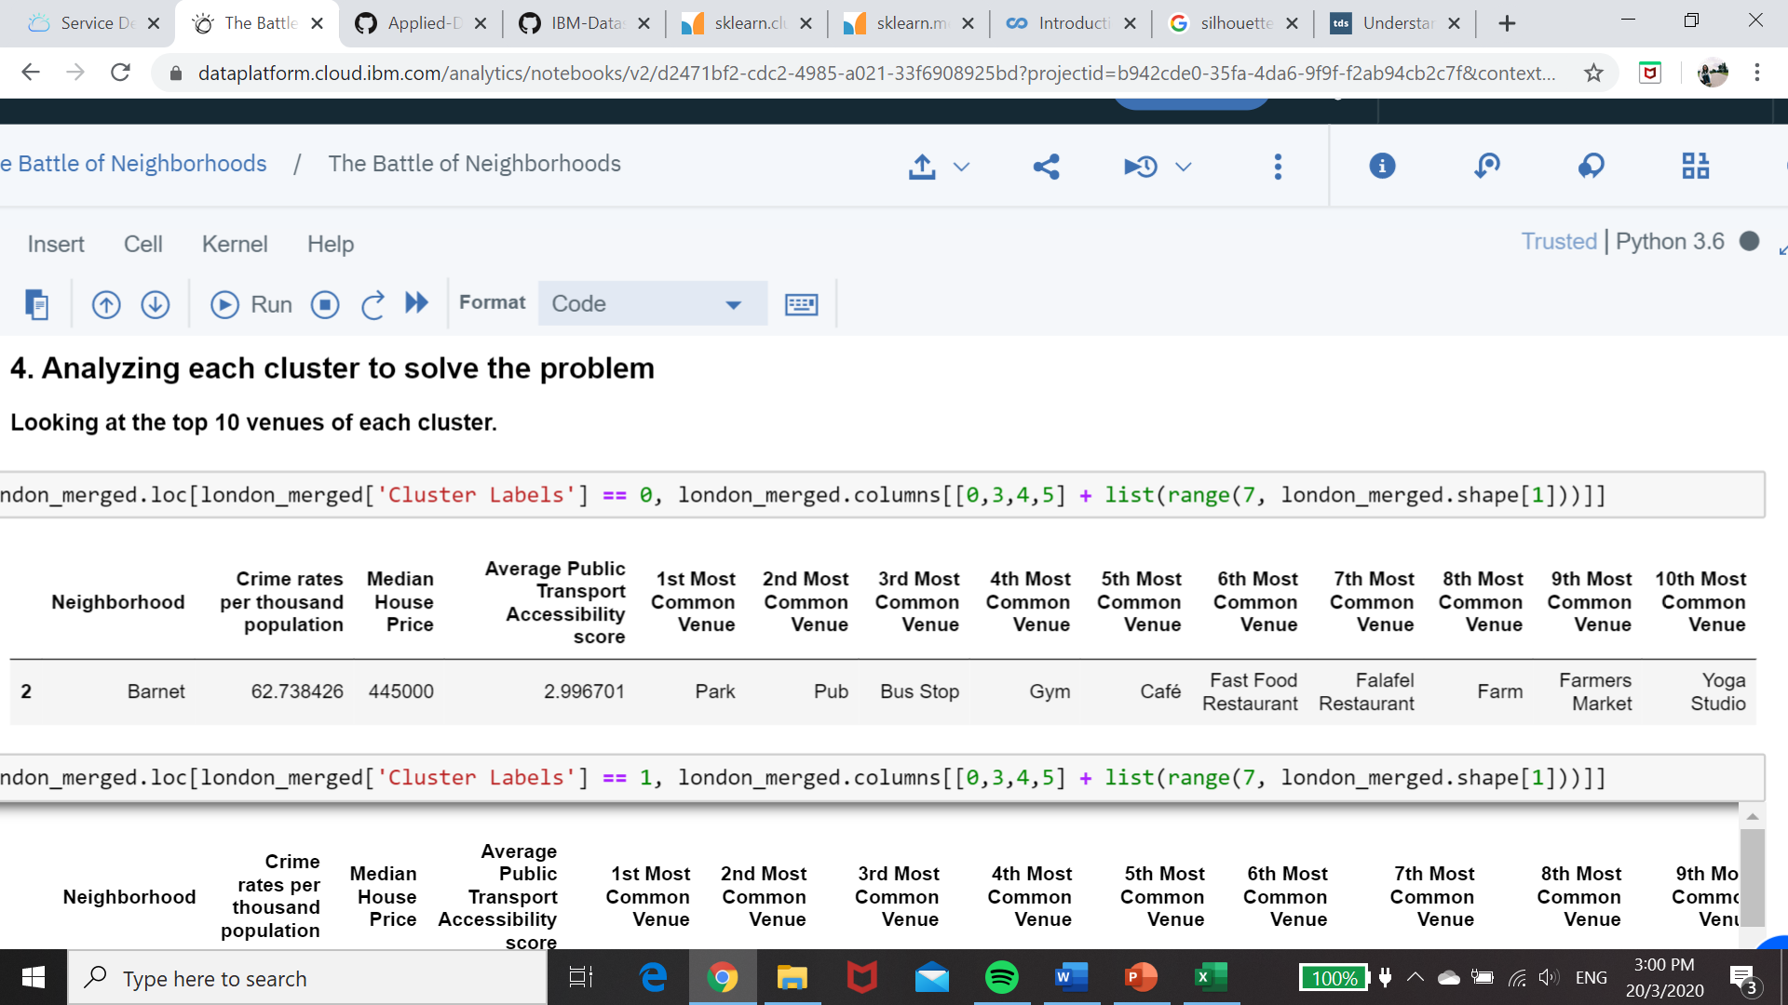
Quiet lifestyle – Barnet
Chosen from cluster 1 that has plenty of green spaces (parks and farms)
Close to eateries and groceries
Relatively low crime rate
Mid-range house prices
Relatively low public transport accessibility, can has many bus stops

Slide 14
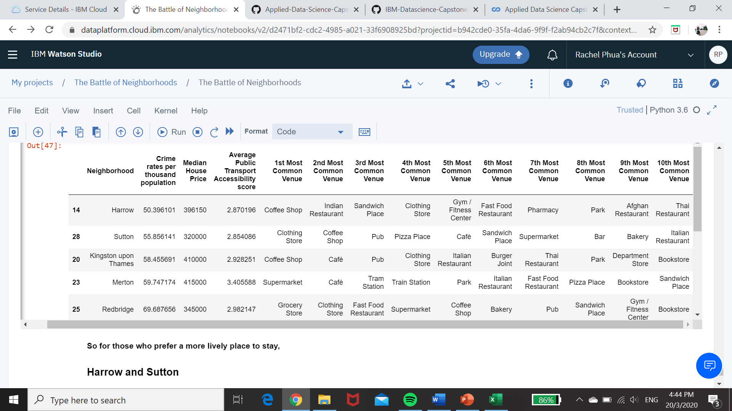
Lively environment – Harrow & Sutton
Chosen from cluster 2 that has more entertainment spaces and retail outlets
Neighborhoods with either hotels or pubs as the top 2 most common venues were removed (it might get too busy!)
Relatively low crime rates and housing prices

Slide 15
conclusion
If you are moving to London, you can consider living in
Barnet
if you prefer a quiet lifestyle
Harrow or Sutton
if you prefer a lively environment

Slide 16


Thank you

